Slide 1
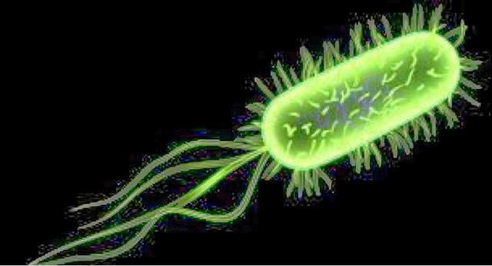
Evolutionary tendencies in Monera
Kingdom Monera is divided into two groups
Archeabacteria
Eubacteria
Archeabacteria:
Ancient bacteria/ most primitive bacteria
Live in extreme and harsh conditions
Extremophiles
Cell wall- polysaccharides and surface layer proteins (S proteins), peptidoglycan is absent in cell wall.
Thermoacidophiles- hot sulphur springs (Sulfobolus)
Methanogene - marshy areas/ gut of cows and buffaloes (Metahnococcus)
Halophiles – Extreme salty conditions (Halococcus)

Slide 2
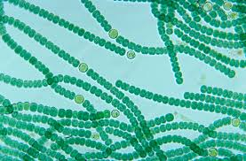
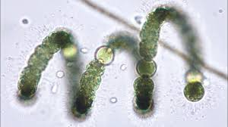
Eubacteria
True bacteria
Autotrophic /Heterotrophic
Photosynthetic/ Chemosynthetic
Cyanobacteria
Pathogenic bacteria
https://www.youtube.com/watch?v=6NV0Bq3qYVU

Slide 3
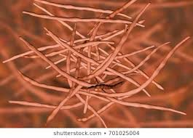
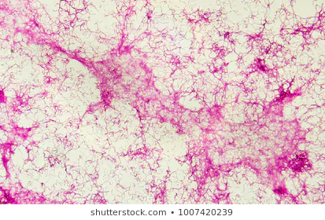
Actinomycetes
Unicellular, branched, filamentous, unique bacteria resembling fungus mycellia.
Radiating filaments
Soil microbe/ ubiquitous
Gram positive
Saprophytic/ Pathogenic

Slide 4
links
https://www.youtube.com/watch?v=6NV0Bq3qYVU
https://www.google.com/search?q=pictures+of+cyanobacteria
https://www.google.com/search?q=Pictures+of+actinomycetes&sourc
https://www.google.com/search?q=Pictures+of+archeaebacteria

